Slide 1
LISTENING SKILLS
ALMETTA WILSON

Slide 6
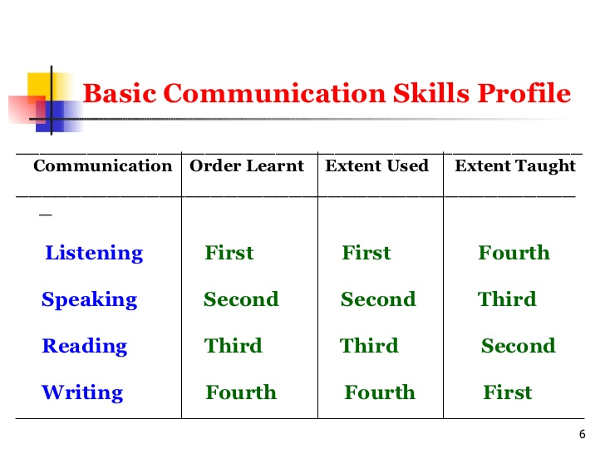

Slide 12
